Slide 1


Design Patterns
Joris Geurts, j.geurts@fontys.nl
Wieger Wesselink, j.w.wesselink@tue.nl

Slide 2
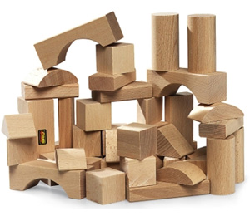
what is a design pattern?
A design pattern is a general reusable solution to a commonly occurring problem in software design.

Slide 3
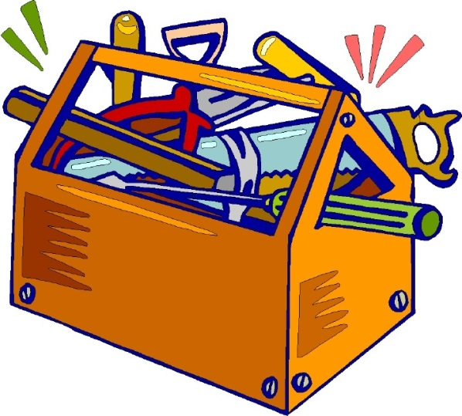
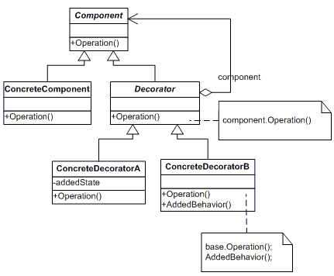
why studying design patterns?
toolbox for common problems
don't reinvent the wheel yourself
common language between software architects

Slide 4
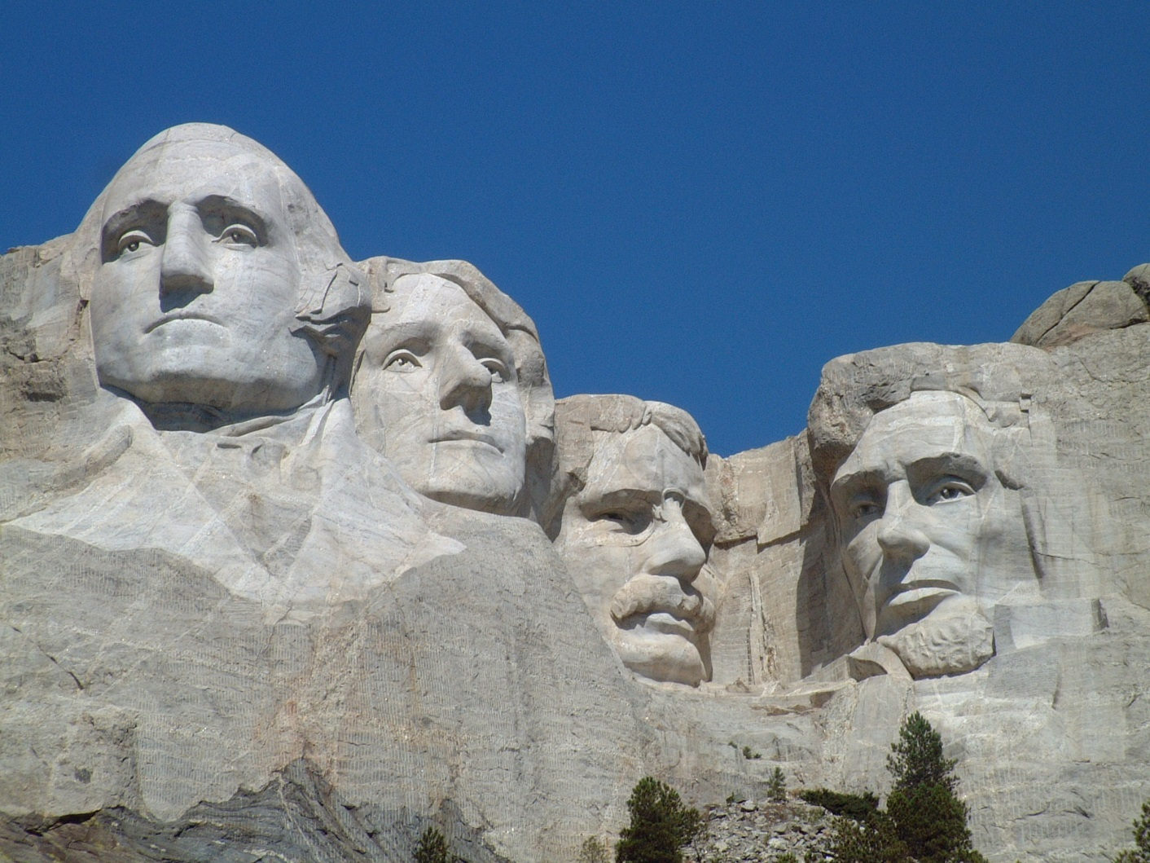
design patterns = communication
I want an architecture such that the requests in the system are encapsulated as objects, such that the clients can be parameterized with different requests and that there is support for undoable operations
…?
What do you mean?
let's use the Command Pattern

Slide 5
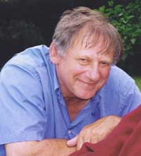
prof. Christopher Alexander:
”Every pattern describes a problem which occurs over and over again in our environment, and then describes the core of the solution to that problem, in such a way that you can use this solution a million times over, without ever doing it the same way twice.“

Slide 6
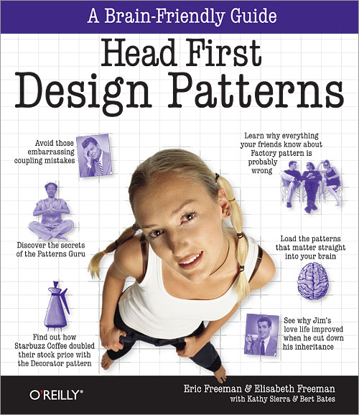
course overview
Strategy Pattern (Ch. 1)
Observer Pattern (Ch. 2)
Abstract Factory Pattern (Ch. 4)
Decorator Pattern (Ch. 3)
Pattern A
Pattern B

Slide 7
course overview (cont.)
6 patterns (Java or C#)
groups of 2 students
weekly delivery in Canvas:
code
UML class diagram (handwritten)
assignments are graded and averaged (max: one 5)
interview week 8
no exam

Slide 8
increased student involvement
wk 4: review each other
wk 5: research for Pattern A
wk 6: teach Pattern A to peers
wk 8: evaluation (interview + classroom)
your presence is mandatory

Slide 9
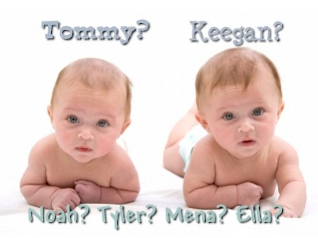



design pattern elements
name
problem
solution
consequences

Slide 10
a. design pattern name
contains the essence of the pattern

Slide 11
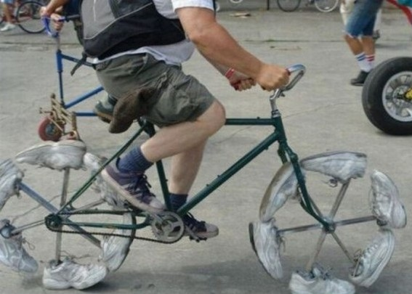

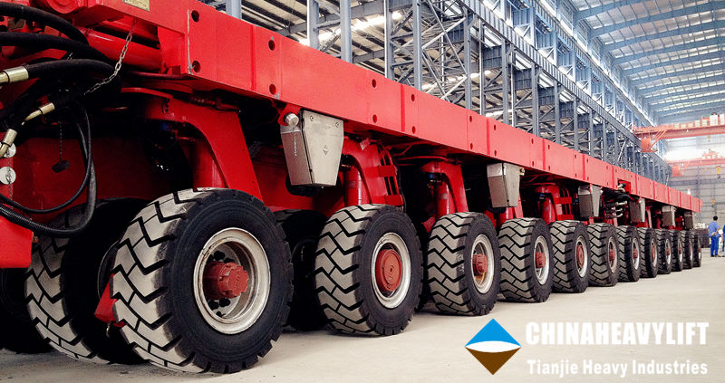
b. design pattern problem
Typically the problem is related to
reusability
extensibility
maintainability

Slide 12
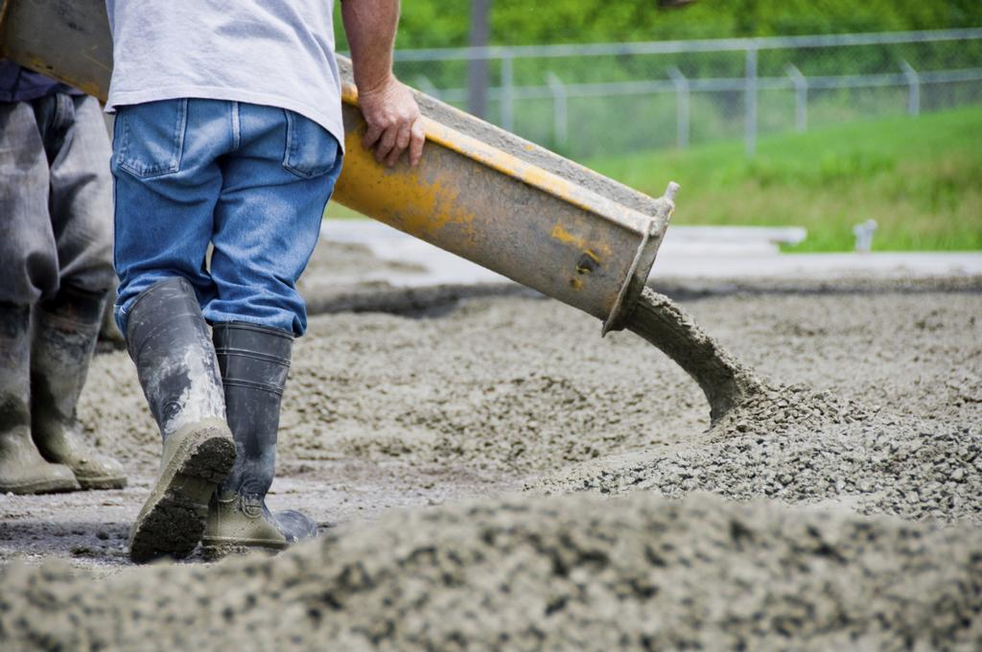
ultimate goal
after writing code: never ever open the file and never change the code again
store in SVN (or Git) and leave it
"pour into concrete"
your file

Slide 13
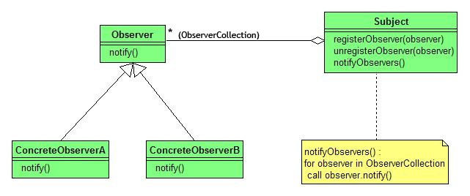
c. design pattern solution
structure (class/object diagram)
participants (classes + objects)
collaborations (how the participants work together)

Slide 14
d. consequences
(+) positive consequences
(-) negative consequences
There are no perfect solutions!

Slide 15
UML repetition

Slide 16
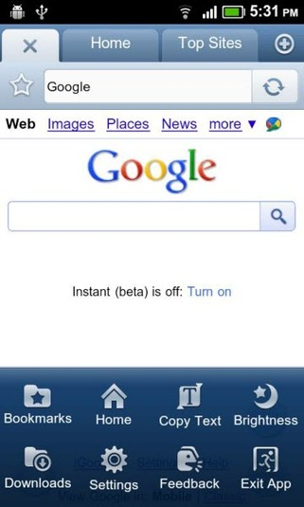
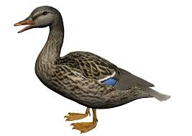

example user requirement
Make a design for ducks that can quack and fly.
There are many different ways of quacking and many different ways of flying.

Slide 17
Solution 1
enum FlyBehavior { FLY1, FLY2, FLY3 };
enum QuackBehavior { QUACK1, QUACK2, QUACK3 };
class Duck
{
FlyBehavior flyBehavior = FlyBehavior.FLY1;
QuackBehavior quackBehavior = QuackBehavior.QUACK2;
void fly1() { System.out.println("fly 1"); }
void quack1() { System.out.println("quack 1"); }
...
public void fly()
{
switch (flyBehavior)
{
case FLY1: fly1(); break;
case FLY2: fly2(); break;
case FLY3: fly3(); break;
}
}
}

Slide 18
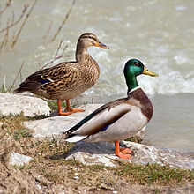
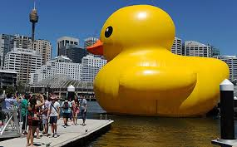
Solution 2: inheritance
class Duck
{
void fly() { ... } // default implementation
void quack() { ... } // default implementation
}
class MallardDuck extends Duck
{
}
class RubberDuck extends Duck
{
void fly() { ... }
void quack() { ... }
}

Slide 19
discussion
Code is duplicated across subclasses?
Runtime behavior changes are difficult?
We can't make ducks dance?
Hard to gain knowledge of all duck behaviors?
Ducks can't fly and quack at the same time?
Changes can affect other ducks by accident?

Slide 20
Solution 3: interfaces
interface Flyable { void fly(); }
interface Quackable { void quack(); }
class MallardDuck implements Flyable, Quackable
{
void fly() { System.out.println("fly 1"); }
void quack() { System.out.println("quack 1"); }
}
class RedheadDuck implements Flyable, Quackable
{
void fly() { System.out.println("fly 2"); }
void quack() { System.out.println("quack 2"); }
}
class RubberDuck implements Flyable, Quackable
{
void fly() { System.out.println("fly 3"); }
void quack() { System.out.println("quack 3"); }
}

Slide 21
Solution 4: delegation
interface FlyBehavior { void fly(); }
interface QuackBehavior { void quack(); }
abstract class Duck
{
FlyBehavior flyBehavior;
QuackBehavior quackBehavior;
void performFly() { flyBehavior.fly(); }
void performQuack() { quackBehavior.quack(); }
}
class MallardDuck extends Duck
{
MallardDuck(QuackBehaviour q, FlyBehaviour f)
{
quackBehavior = q;
flyBehavior = f;
}
}
class FlyWithWings implements FlyBehavior
{
void fly() { System.out.println("I'm flying");}
}
class Quack implements QuackBehavior
{
void quack() { System.out.println("Quack"); }
}
public static void main()
{
QuackBehaviour qu = new Quack();
FlyBehaviour fw = new FlyWithWings();
Duck m = new MallardDuck(qu,fw);
QuackBehaviour pe = new Peep();
FlyBehaviour df = new DoNotFly();
Duck r = new RubberDuck(pe,df);
m.performFly();
r.performQuack();
}

Slide 22
some advantages of solution 4
Fly and quack behaviors can be reused
New behaviors can be added without modifying existing Duck classes
Behaviors can be changed at run-time
I can unit test Duck without depending on implementations for Flyable and Quackable

Slide 23
design principles
Identify the aspects of your application that vary and separate them from what stays the same.
Program to an interface, not an implementation.
Favor aggregation over inheritance

Slide 24
Strategy Pattern
Define a family of algorithms, encapsulate each one, and make them interchangeable. Strategy lets the algorithm vary independently from clients that use it.

Slide 25
the problem
Given a context in which an algorithm is used, you want to:
use different algorithms depending upon the situation
avoid having to change the context (a.k.a. client)

Slide 26
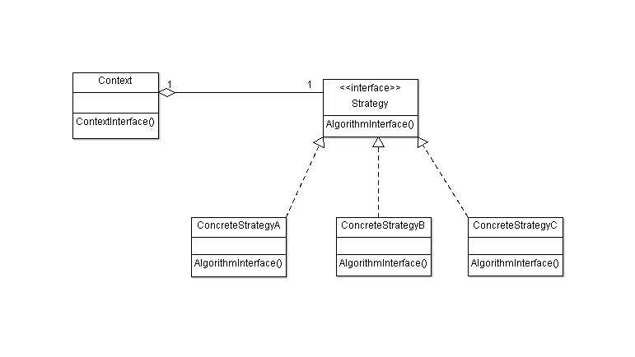
the solution

Slide 27
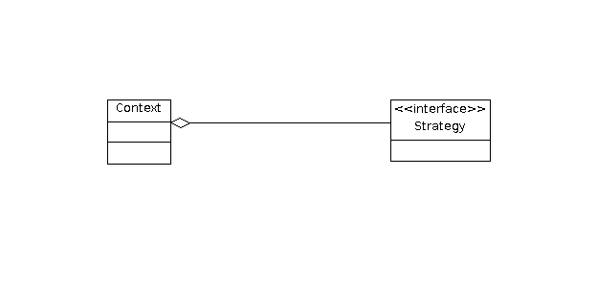
Has-A Relationship
UML:
Head First:
Favor aggregation over inheritance

Slide 28
consequences
(+) Eliminate conditional statements
(+) Choice of implementations
(+) Families of related algorithms
(+) Alternative to sub classing
(-) Application must be aware of different strategies
(-) Communication overhead
(-) Increased number of objects

Slide 29


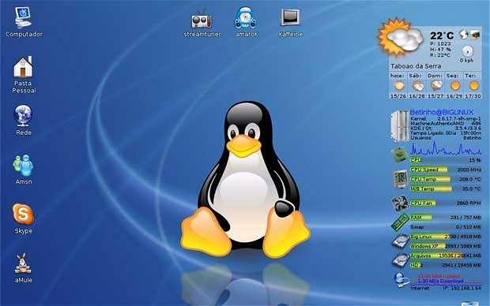

Strategy assignment
Apply the Strategy pattern for Disk Scheduling

Slide 30
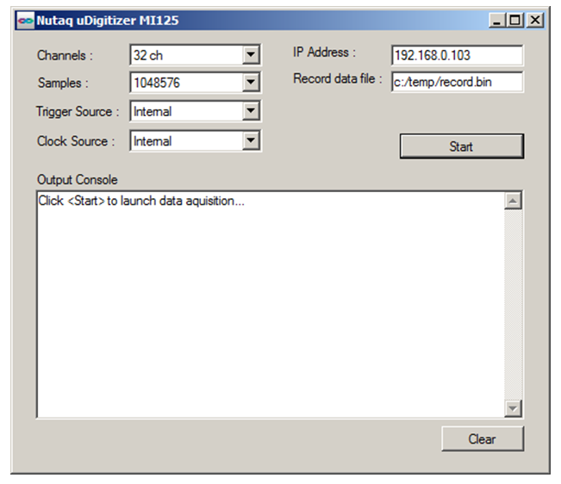
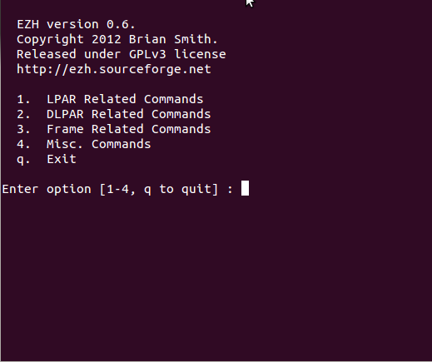
user interface
GUI or CLI?
use the easiest way (but lecturer prefers GUI…)

Slide 31
way of working
start with default pattern UML
find role of your classes -> draw UML according your application
coding & testing
reflection ("am I happy?", "still things to improve?")

Slide 32
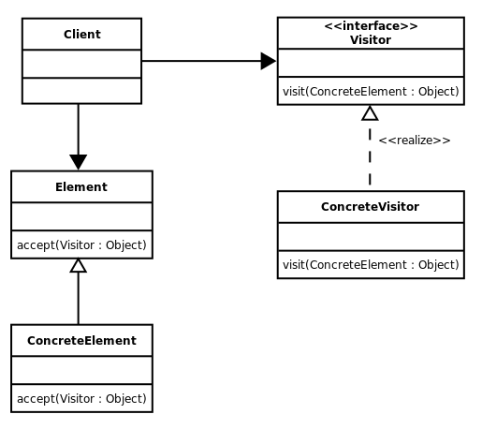

UML
Business Logic
(timer tick or thread)
GUI
create
reusability?
maintainability?
extensibility?
create
create
Notes:
visitor pattern

Slide 33
criteria for grading
handwritten UML, correct notation, all classes of application
implementation according to original pattern
proper names for methods and variables
application shows strength of pattern
discuss the 3 problems (no Copy&Paste from wiki)
program runs properly, easy to use, results are clear
submission in time (one day too late: -1, etc.)

Slide 34
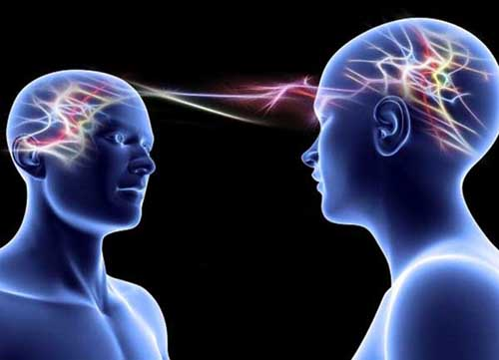
bonus
new project with improvements (+ doc)
… (your intellectual creativity)
your lecturer has no telepathic brain, so add a document to show your intelligence!!!
"if I have to guess, I always guess wrong"

